Slide 1
Power Decisions’ Methodology
Fig. 1.3
Opportunity scan
Solve Problem
Option generation
Refine options
Decision
Client
Needs
Find
Seek
Plan
Act
Achieve Goal
How We
Help
Research
Evaluate
Interpret
Facilitate
Market
Plan
Advise
Assist
Execution
Clarify
Decisions
Analysis
Recommend
Research

Slide 2

Chapter 2
Defining the marketing research problem and developing a research approach

Slide 3

Chain Restaurant Study
One day I received a phone call from a research analyst who introduced himself as one of our alumni.
He was working for a restaurant chain in town and wanted help analyzing the data he had collected while conducting a marketing research study.

Slide 4

Chain Restaurant Study
When we met, he presented me with a copy of the questionnaire and asked how he should analyze the data. My first question to him was,
What is the problem being addressed?

Slide 5

Chain Restaurant Study
When he looked perplexed, I explained that data analysis is not an independent exercise.
Rather, the goal of data analysis is to PROVIDE INFORMATION RELATED TO THE PROBLEM COMPONENTS.

Slide 6


Chain Restaurant Study
I was surprised to learn that he did not have a clear understanding of the marketing research problem and that a written definition did not exist. So before going any further, I had to define the marketing research problem.
Once that was done, I found that much of the data collected was not relevant to the problem. In this sense, the whole study was a waste of resources. A new study had to be designed and implemented to address the problem defined.

Slide 7

The Problem Definition Process
Fig. 2.1
Tasks Involved
Discussion
Interviews
Secondary
Qualitative
with
with
Data
Research
Decision Maker(s)
Experts
Analysis
Environmental Context of the Problem
Step I: Problem Definition
Management Decision Problem
Marketing Research Problem
Step II: Approach to the Problem
Objective/
Analytical Model: Verbal, Graphical, Mathematical
Specification
of
Information
Needed
Theoretical
Research
Hypotheses
Foundations
Questions
Step III: Research Design

Slide 8
Management Decision Problem vs. Marketing Research Question

Slide 9



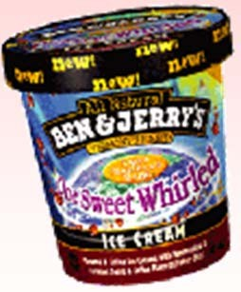

Decision Problem: Develop a new package
Research Question: Evaluate alternative package designs
Black: sexy, bad boy & bad girl image
Blue and purple: fun, pure, healthy

Slide 10

Table 2.3 Management-Decision Problem and Marketing Research Problem
Management-Decision Problem Marketing Research Problem
Should a new product be introduced?
To determine consumer preferences and purchase intentions for the proposed new product.
Should the advertising campaign be changed?
To determine the effectiveness of the current advertising campaign.
Should the price of the brand be increased?
To determine the price elasticity of demand and the impact on
sales and profits of various levels of price changes.

Slide 11

Table 2.3 Management-Decision Problem and Marketing Research Problem (Cont.)
Management-Decision Problem Marketing Research Problem
What can Subaru do to expand its automobile market?
To determine the various needs of the automobile users and
the extent to which those needs were being satisfied by the
current product offering

Slide 12

Figure 2.7 Errors in Defining the Market Research Problem
Common Errors
Problem Definition is too Broad
Does Not Provide Guidelines for Subsequent Steps
e.g., Improving the Company’s Image
Problem Definition is too Narrow
May Miss Some Important Components of the Problem
e.g. Changing Prices in Response to a Competitor’s Price Change

Slide 13

The New Coke Fiasco
Worried about “The Pepsi Challenge,” Coke conducts blind taste tests on 200,000 consumers, at a cost of
$4 mil. in 1984.
These taste tests reveal that consumers overwhelmingly prefer its new formula to both its old formula and Pepsi!
Coke retires its old formula and introduces “New Coke” in 1985.
“New Coke” is a big flop, with consumers boycotting the product and crying bloody murder!

Slide 14
What went wrong?
Consumer preferences for Coke were not driven by taste!
Consumer preferences for Coke were driven by emotional factors.
Coke revived “Classic Coke” after 3 months and made “New Coke” a line extension.
Now, “brand cluster loyalty” drives existence of different types of Coke (Classic, New, Cherry).

Slide 15
Figure 2.8 Proper Definition of the Marketing Research Problem
Marketing Research Problem
Broad Statement
Component 1
Component 2
Component 3
SPECIFIC COMPONENTS

Slide 16
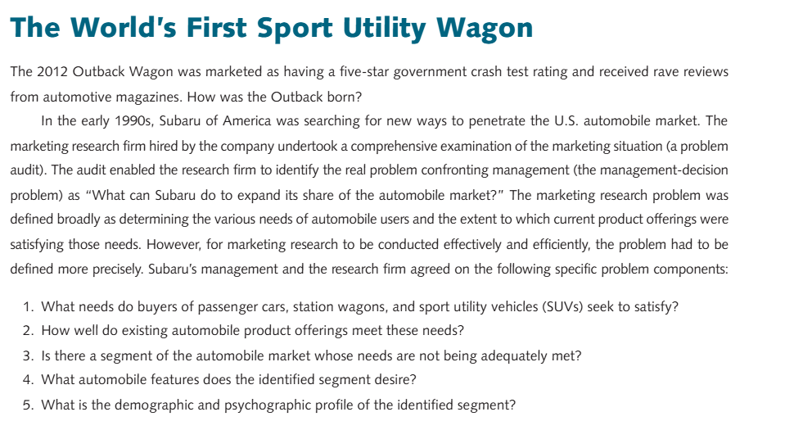
Subaru Vignette (Part 1)

Slide 17
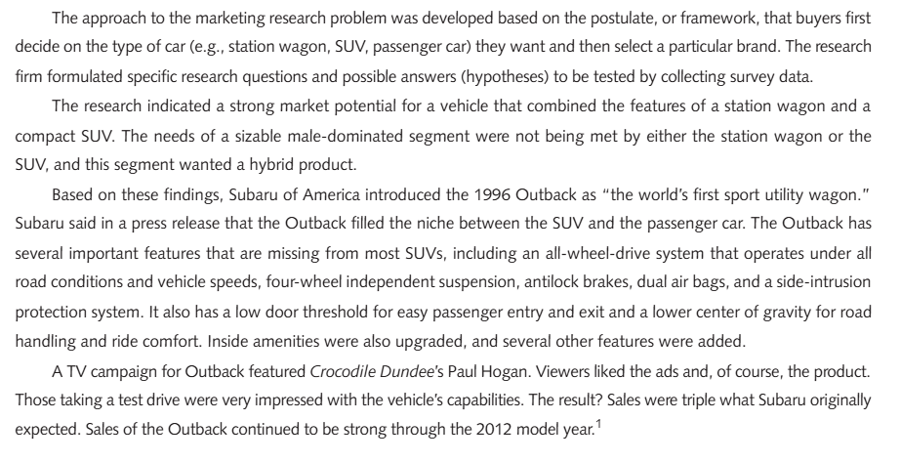
Subaru Vignette (Part 1)

Slide 18

Subaru Vignette
Management-Decision Problem:
“What can Subaru do to expand its share of the automobile market?”
Marketing Research Problem:
Determining the various needs of automobile users and the extent to which current product offerings were satisfying those needs.

Slide 19

Subaru: Specific Components
What needs do buyers of passenger cars, station wagons, and sports utility vehicles seek to satisfy?
How well do existing automobile product offerings meet these needs?
Is there a segment of the automobile market whose needs are not being adequately met?
What automobile features does the segment identified in number 3 desire?
What is the demographic and psychographic profile of the identified segment?

Slide 20
Components of an Approach
Objective/Theoretical Foundations
Analytical Model
Research Questions
Hypotheses
Specification of the Information Needed

Slide 21
The Role of Theory in Applied
Marketing Research
Research Task
Role of Theory
1. Conceptualizing
Provides a conceptual foundation and understanding of the basic processes
and identifying
underlying the problem situation. These processes will suggest key dependent
key variables
and independent variable
s.
2. Operationalizing
Theoretical constructs (variables) can suggest independent and dependent
key variables
variables naturally occurring in the real world.
3. Selecting a
Causal or associative relationships suggested by the theory may
indicate whether
research design
a causal or descriptive design should be adopted.
4. Selecting a
The theoretical framework may be useful in defining the population and
sample
suggesting variables for qualifying respondents, imposing quotas, or stratifying
the population
(see Chap. 11).
5. Analyzing and
The theoretical framework (and the models, research questions and hypotheses
interpreting data
based on it) guide the selection of a data analysis strategy and the interpretation
of results (see Chap. 14).
6. Integrati
ng
The findings obtained in the research project can be interpreted in the light of
findings
previous research and integrated with the existing body of knowledge.

Slide 22

Models
An analytical model is a set of variables and their interrelationships designed to represent, in whole or in part, some real system or process.
In verbal models, the variables and their relationships are stated in prose form. Such models may be mere restatements of the main tenets of a theory.

Slide 23



Graphical Models
Graphical models are visual. They are used to isolate variables and to suggest directions of relationships but are not designed to provide numerical results.
Awareness Understanding: Evaluation
Preference Patronage

Slide 24


Mathematical Models
Mathematical models explicitly specify the relationships among variables, usually in equation form.
n
y = _{a 0} + ∑ _{a i xi}
i =1
Where
y = degree of preference
a0 , ai
= model parameters to be estimated statistically

Slide 25
Figure 2.9 Development of Research Questions & Hypothesis
Components of the Marketing Research Problem
Analytical Framework and Models
Research Questions
Hypotheses

Slide 26

Research Questions and Hypotheses
Research questions (RQs) are refined statements of the specific components of the problem.
A hypothesis (H) is an unproven statement or proposition about a factor or phenomenon that is of interest to the researcher. Often, a hypothesis is a possible answer to the research question.

Slide 27
Subaru Vignette
RQ : What is the overlap between the features sought by station wagon buyers and buyers of sports utility vehicles (SUVs)?
H1 : The buyers of station wagons rate certain features of SUVs as important.
H2 : The buyers of SUVs rate certain features of station wagons as important.

Slide 28

Specification of Information Needed
By focusing on each component of the problem and the analytical framework and models, research questions, and hypotheses, the researcher can determine what information should be obtained.

Slide 29

Subaru Vignette
Component 1
Needs of buyers of passenger cars operationalized in terms of the attributes or features desired in an automobile.
Needs of buyers of station wagons operationalized in terms of the attributes or features desired in an automobile.
Needs of buyers of sports utility vehicles operationalized in terms of the attributes or features desired in an automobile.

Slide 30
Subaru Vignette
Component 2
Evaluation of passenger cars on the desired attributes.
Evaluation of station wagons on the desired attributes.
Evaluation of sports utility vehicles on the desired attributes.

Slide 31

Subaru Vignette
Component 3
No new information to be collected.
Component 4
No new information to be collected.
Component 5
Demographic and psychographic characteristics. Type and number of automobiles owned.

Slide 32
Department Store Project
Problem Definition
In the department store project, the marketing research problem is to determine the relative strengths and weaknesses of Sears, vis-à-vis other major competitors, with respect to factors that influence store patronage. Specifically, research should provide information on the following questions.
1. What criteria do households use when selecting department stores?
2. How do households evaluate Sears and competing stores in terms of the choice criteria identified in question 1?
3. Which stores are patronized when shopping for specific product categories?
4. What is the market share of Sears and its competitors for specific product categories?
5. What is the demographic and psychological profile of the customers of Sears? Does it differ from the profile of customers of competing stores?
6. Can store patronage and preference be explained in terms of store evaluations and customer characteristics?

Slide 33
Department Store Project
RQ: Do the customers of Sears exhibit store loyalty?
H1: Customers who are store loyal are less knowledgeable about the shopping environment.
H2: Store-loyal customers are more risk-averse than are non-loyal customers.

Slide 34
Department Store Project
Specification of Information Needed
Component 1
The researcher identified the following factors as part of the choice criteria: quality of merchandise, variety and assortment of merchandise, returns and adjustment policy, service of store personnel, prices, convenience of location, layout of store, credit and billing policies. The respondents should be asked to rate the importance of each factor as it influences their store selection.
Component 2
The researcher identified nine department stores as competitors to Sears based on discussions with management. The respondents should be asked to evaluate Sears and its nine competitors on the eight choice criteria factors.

Slide 35
Department Store Project
Component 3
Sixteen different product categories were selected, including women's dresses, women's sportswear, lingerie and body fashion, junior merchandise, men's apparel, cosmetics, jewelry, shoes, sheets and towels, furniture and bedding, and draperies. The respondents should be asked whether they shop at each of the ten stores for each of the 16 product categories.
Component 4
No additional information needs to be obtained from the respondents.

Slide 36
Department Store Project
Component 5
Information should be obtained on the standard demographic characteristics and the psychographic characteristics of store loyalty, credit use, appearance consciousness, and combining shopping with eating.
Component 6
No additional information needs to be obtained from the respondents.

Slide 37
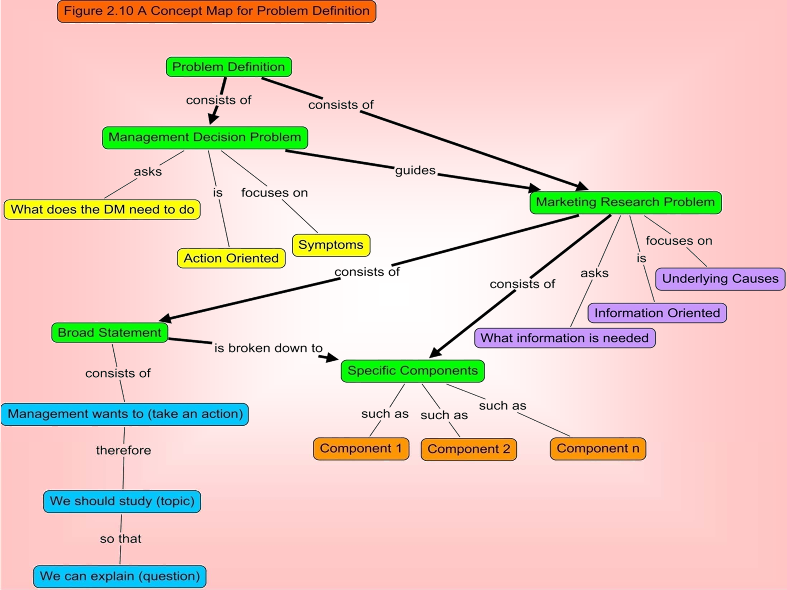

Slide 38
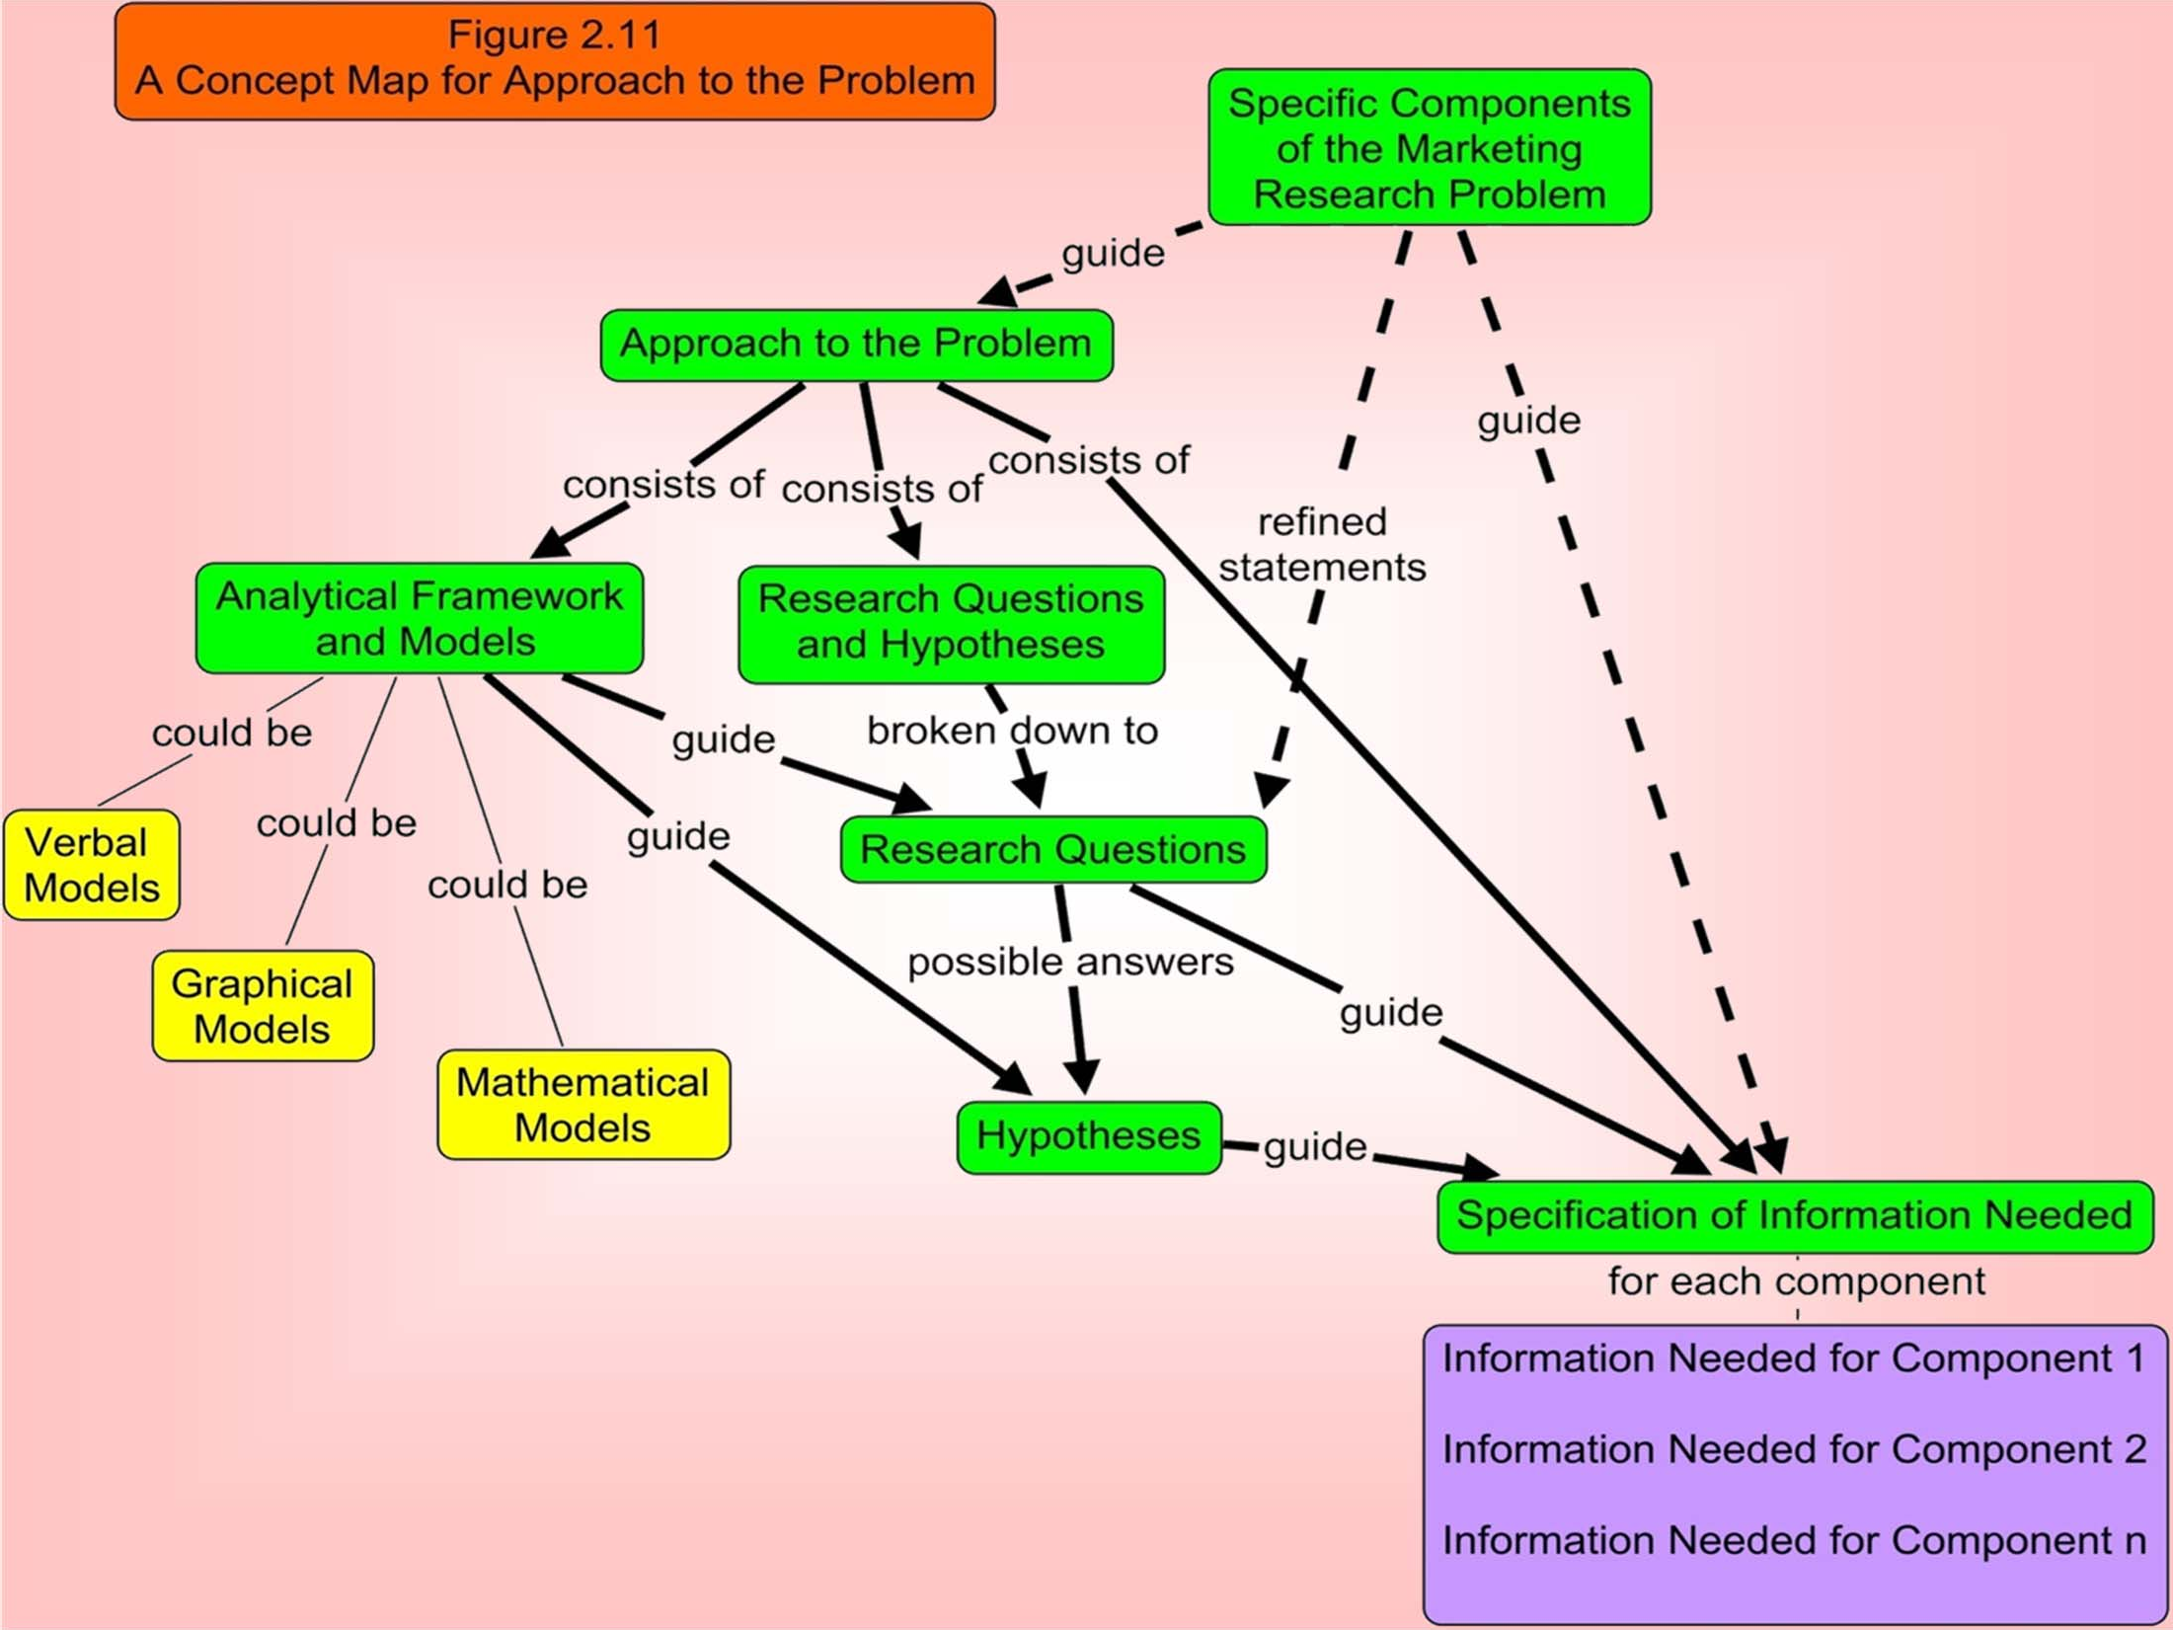

Slide 39
In-class exercise
For the following scenarios spot what the management decision problem is then try to come up with appropriate marketing research problem.
Try to find the components, research questions and hypotheses of the marketing research problem. Make any assumption you believe is necessary:
1: "Sales of our new eco-friendly water bottle are not meeting targets."
2: "We need to decide if we should open a new store in a different neighborhood."
3: "Our social media engagement is low, and we need to improve it."
4: "We are planning to launch a new line of vegan snack bars and need to know the optimal price."

Slide 40
Lets summarize:
Management Decision Problem (MDP) — what management must decide or act upon.
Marketing Research Problem (MRP) — what information is needed to support that decision.
Components of the MRP — what sub-issues or dimensions need to be studied.
Research Questions (RQs) — what specific questions the study will answer.
Hypotheses (Hs) — tentative answers that can be tested statistically.
Assumptions (if any) — stated conditions to make the problem realistic.

Slide 41
Case 1
Sales of our new eco-friendly water bottle are not meeting targets
Management Decision Problem (MDP):
Determine how to increase sales of the new eco- friendly water bottle.
Marketing Research Problem (MRP):
Identify the factors affecting the low sales performance of the new water bottle and assess customer perceptions, preferences, and awareness.
Components:
Customer awareness and attitudes toward the product.
Perceived value and pricing.
Distribution coverage and availability.
Effectiveness of current promotions and advertising.
Competitive positioning.

Slide 42
Case 1 cntd
Research Questions (RQs):
Are consumers aware of our eco-friendly water bottle?
How do consumers perceive its price and quality compared to competitors?
What features or benefits do customers value most in eco-friendly bottles?
Are current distribution channels convenient for the target market?
Hypotheses (Hs):
H₁: Awareness of the eco-friendly bottle among target consumers is low.
H₂: Consumers perceive the product as overpriced relative to competitors.
H₃: Promotion and advertising messages are not effectively communicating the product’s eco-friendly benefits.
Assumption:
The product is available in major retail outlets but is facing competition from established eco-friendly brands.

Slide 43
Case 2
We need to decide if we should open a new store in a different neighborhood.
MDP:
Decide whether opening a new retail store in a different neighborhood is a profitable move.
MRP:
Assess market potential, customer demand, and competitive conditions in the target neighborhood to determine the feasibility of a new store.
Components:
Market size and demographics.
Consumer shopping behavior and preferences.
Competitive landscape.
Estimated sales potential and profitability.

Slide 44
Case 2 cntd
RQs:
Is there sufficient demand for our products in the targe neighborhood?
What are the demographic and psychographic profiles of consumers in the area?
How saturated is the local market with similar stores?
What are consumers’ expectations regarding store location, pricing, and assortment?
Hs:
H₁: The target neighborhood has a sufficient number of potential customers to support a new store.
H₂: Competitor density in the area is moderate to low.
H₃: Residents in the area prefer in-person shopping for this product category.
Assumption:
Company already operates in nearby locations and has access to demographic data for surrounding neighborhoods.

